Slide 1


Netflix Stock Price Analysis Using RNN and lstm
Team – ULTRON
Team members :- AKSHAT(01411503122)
SHASHANK(01511503122)
ANUVANSH KAUSHIK (02711503122)
RAGHAV GARG(02911503122)

Slide 2


Introduction to the Netflix Stock Price Analysis Project
This project aims to analyze the stock price of Netflix, a leading global streaming entertainment service. By leveraging Recurrent Neural Network (RNN) and LSTM models, we will analyze historical Netflix stock data to forecast the company's stock price movements.

Slide 3
Understanding the Netflix Business Model
Subscription-Based Revenue
Content Production
Global Expansion
The company invests heavily in producing and acquiring exclusive content to attract and retain subscribers.
Netflix has expanded its service to over 190 countries, driving international subscriber growth and revenue.
Netflix generates the majority of its revenue through monthly subscription fees paid by its worldwide subscriber base.

Slide 4

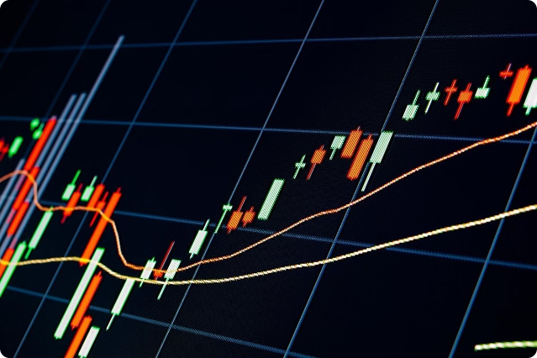
Importance of Stock Price Analysis for Investors
1
Informed Investment Decisions
Accurate stock price analysis can help investors make informed decisions about when to buy, hold, or sell Netflix shares.
2
Risk Mitigation
Analyzing stock price movements can assist investors in managing their portfolio risk and maximizing returns.
3
Market Insights
Stock price analysis can provide valuable insights into the overall performance and trends of the Netflix business.

Slide 5



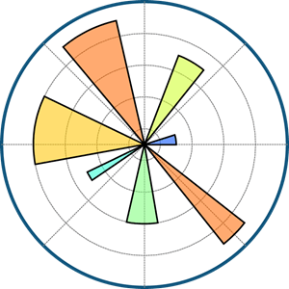


Our Tech Stack

Slide 6


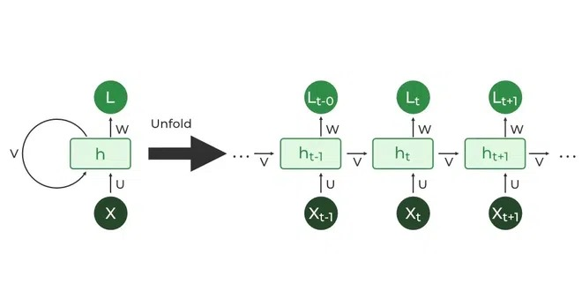



Designing the RNN Architecture for Stock Price Analysis
Input Layer
The RNN model's input layer receives the preprocessed and engineered Netflix stock data.
Hidden Layers
The RNN's hidden layers, such as LSTM or GRU units, capture the sequential patterns and long-term dependencies in the data.
Output Layer
The output layer of the RNN model generates the predicted future stock prices for Netflix.
Dense Layer
The dense layer is a simple Layer of neurons in which each neuron receives input from all the neurons of the previous layer, thus called as dense. .

Slide 7
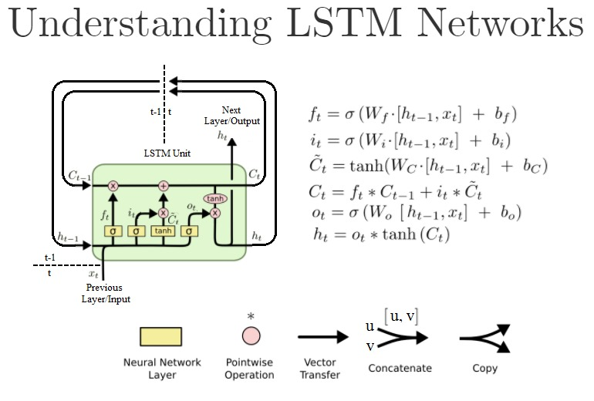
LSTM MODEL
A traditional RNN has a single hidden state that is passed through time, which can make it difficult for the network to learn long-term dependencies. LSTMs model address this problem by introducing a memory cell, which is a container that can hold information for an extended period.
Bidirectional LSTM ModelBidirectional LSTM (Bi LSTM/ BLSTM) is recurrent neural network (RNN) that is able to process sequential data in both forward and backward directions. This allows Bi LSTM to learn longer-range dependencies in sequential data than traditional LSTMs, which can only process sequential data in one direction.

Slide 8
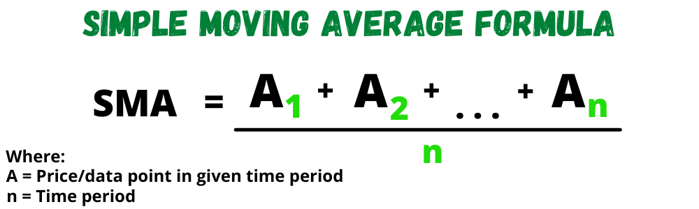
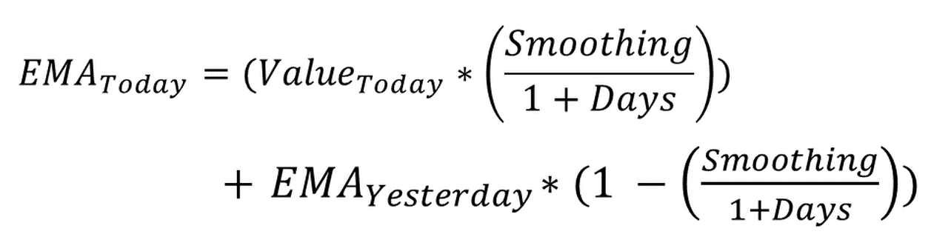
Features/Indicators in our data
Simple Moving Average (SMA) It is simply the average price over the specified period. The average is called "moving" because it is plotted on the chart bar by bar, forming a line that moves along the chart as the average value changes. SMAs are often used to determine trend direction.
Exponential Moving Average (EMA full form in stock market) is a kind of moving average that places a greater weight and importance on the most current data points. It is used for evaluating the bullish and bearish trends in securities over a certain span of duration.

Slide 9
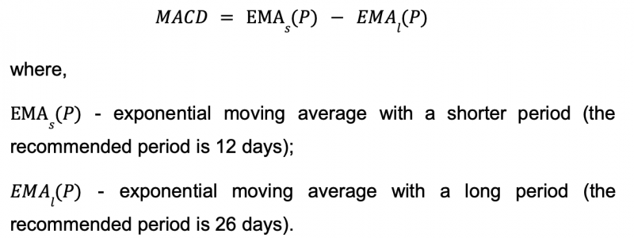
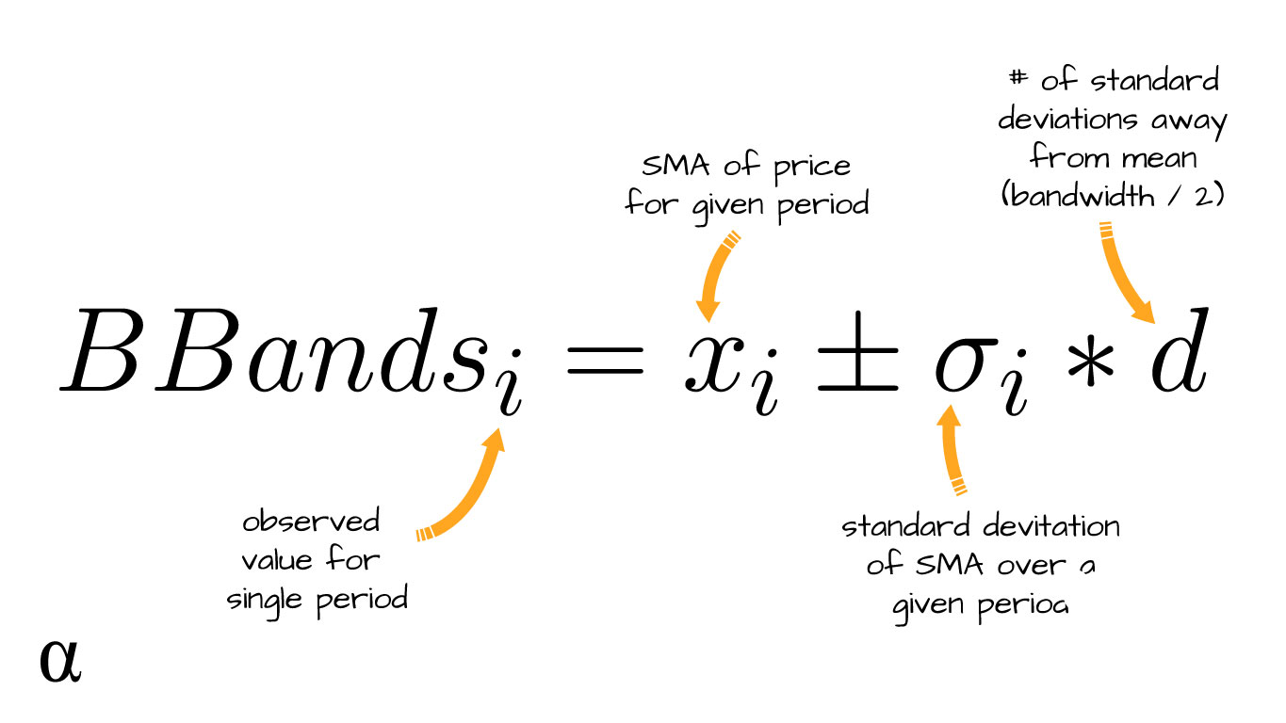
Features/Indicators in our data
Moving average convergence/divergence(MACD) is a technical indicator to help investors identify market entry points for buying or selling. The MACD line is calculated by subtracting the 26-period exponential moving average (EMA) from the 12-period EMA.
Bollinger Bands are envelopes plotted at a standard deviation level above and below a simple moving average of the price. Because the distance of the bands is based on standard deviation, they adjust to volatility swings in the underlying price. Bollinger Bands use 2 parameters, Period and Standard Deviations.

Slide 10
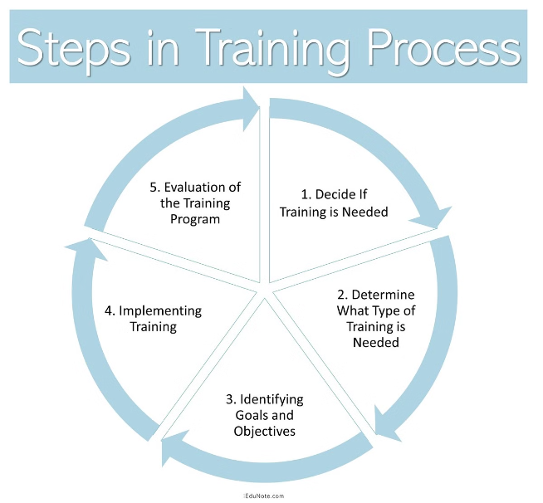

Training and Evaluating the RNN Model
1
Model Training
Train the RNN model on the historical Netflix stock data, using techniques like backpropagation through time to update the model parameters.
2
Model Validation
Continuously evaluate the model's performance on the validation set during training to monitor for overfitting and underfitting.
3
Hyperparameter Tuning
Iteratively adjust the RNN model's hyperparameters to find the optimal configuration that maximizes the model's predictive accuracy.

Slide 11
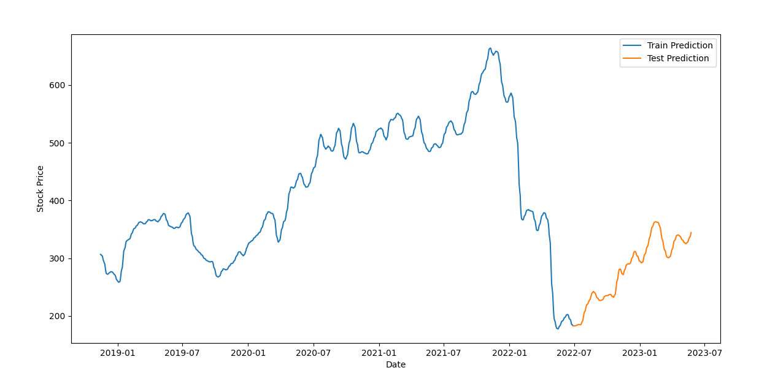
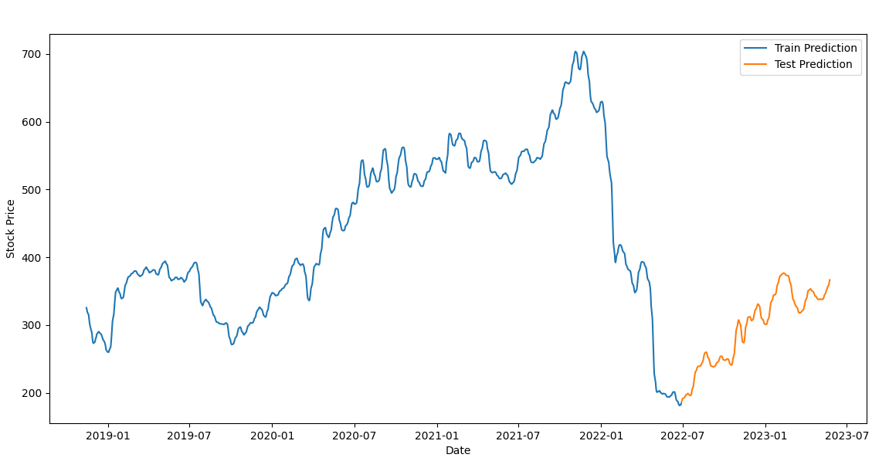
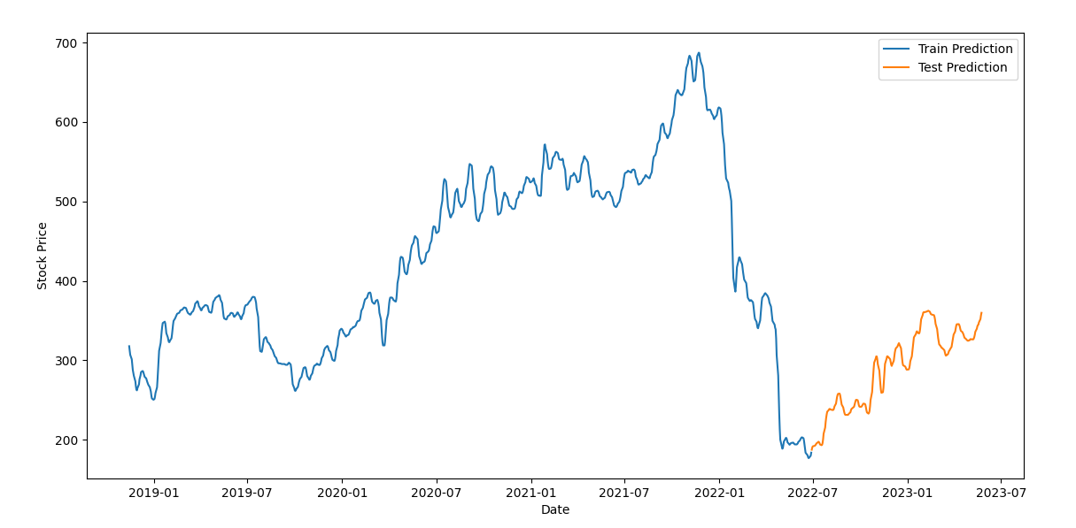
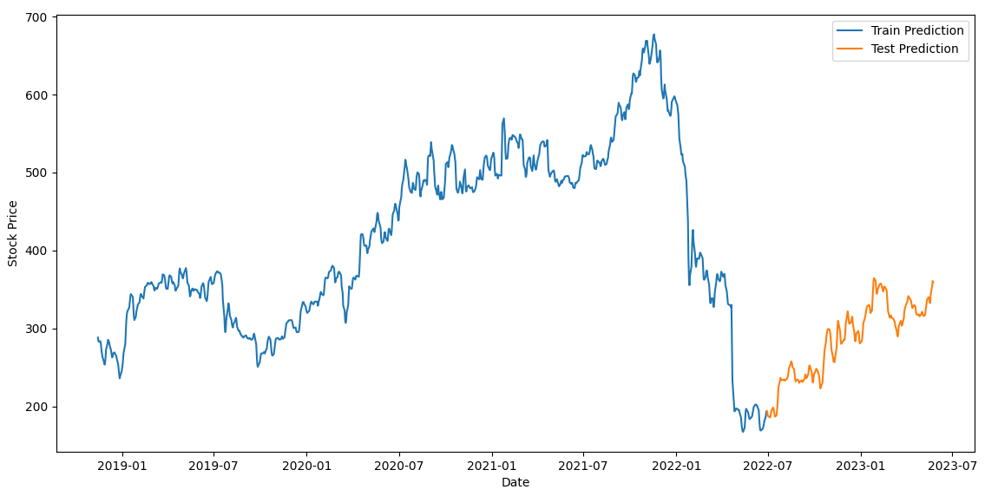
Visualizations
12 epochs
25 epochs
50 epochs
100 epochs

Slide 12
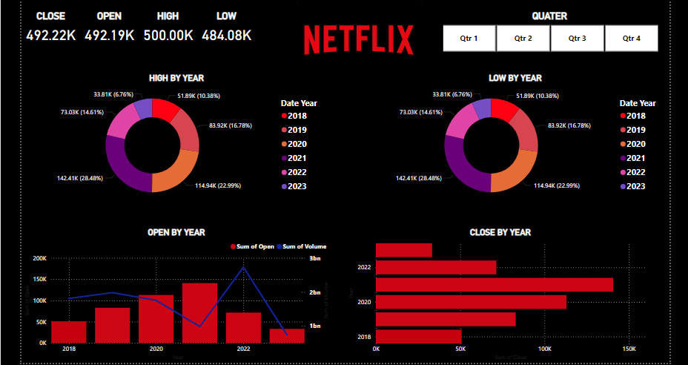

Slide 13


Analyzing the Model's Performance
Metric
Value
Root Mean Squared Error (RMSE)
0.02651
Mean squared Error (MSE)
0.00070
The RNN model's high analyzing performance and low error metrics indicate its effectiveness in forecasting Netflix's stock price movements. These results demonstrate the model's potential to provide valuable insights for investors.

Slide 14


Conclusion and Future Improvements
1
Conclusion
This project has successfully developed an RNN-based model to accurately analyze Netflix's stock price, providing a valuable tool for investors.
2
Future Improvements
Potential enhancements include incorporating additional data sources, exploring alternative RNN architectures, and integrating the model into a real-time stock trading system.
3
Wider Application
The techniques and insights gained from this project can be applied to analyze the stock prices of other companies, contributing to more informed investment decisions.

